Slide 1
Literature Surveys & Frameworks

Slide 2

The methodology/framework is like a Tool Kit that details the whole approach/strategy for evaluating/testing your project’s aim/research question/hypothesis.
A method/s are the tool/s in that tool kit used to evaluate

Slide 3

Research Method vs Research Methodology
The research method is defined as the procedure or technique applied by the researcher to undertake research. On the other hand, research methodology is a system of methods, used scientifically for solving the research problem.
The research method is nothing but the behaviour or tool, employed in selecting and building research technique. Conversely, research methodology implies the science of analysing, the manner in which research is conducted appropriately.
(Surbhi 2018)
SURBHI S, S., 2018. Difference Between Research Method and Research Methodology (with Comparison Chart) [viewed 11 July 2023]. Available from: https://keydifferences.com/difference-between-research-method-and-research-methodology.html#ComparisonChart

Slide 4
Research Method vs Research Methodology
Research method covers various investigation techniques.
The Research methodology is the complete approach aligned the project aim.
(Surbhi 2018)
SURBHI S, S., 2018. Difference Between Research Method and Research Methodology (with Comparison Chart) [viewed 11 July 2023]. Available from: https://keydifferences.com/difference-between-research-method-and-research-methodology.html#ComparisonChart

Slide 5
Process
Evaluative
Project management
Development tools & Process Tools – software & platforms
Process methods Waterfall & Agile etc.
Marking benchmarking Performance testing
Data collection Measuring
Feedback

Slide 6

Process methods
Process methods will make up a simple section of your report. They are simply a list of important tools and management processes that you used to deliver your project. For instance, you may have used:
Software, tools & platforms
Trello and a Gant chart to handle task management
OneNote as a research log
Process Methods

Slide 7
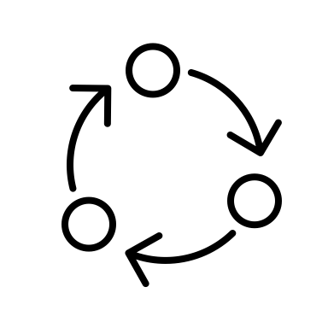
Evaluative methods
Evaluative methods can be split between qualitative, quantitative and mixed (a mixture of qualitative and quantitative). Qualitative data is non-numerical and can be used to get rich contextual user opinion on your project artefact.
Quantitative data is numeric and is used to prove or disprove a hypothesises. Regardless of whether you pick qualitative, quantitative or mixed methods, consider how you gather this data.

Slide 8

Data Collection
In order to collect data, you need to set up some form of experiment or planned evaluation of your artefact. This may be getting some targeted end users to test your web app or software. Or, if you're a networking student, measuring key performance variables on a simulation or real-life network.

Slide 9

Systematic methods Systematic methods, also known as systematic approaches or systematic processes, refer to structured and organised approaches to problem-solving, decision-making, or analysis. These methods are designed to provide a systematic and logical framework for tackling complex problems or tasks, ensuring that all relevant factors are considered and evaluated in a consistent manner.

Slide 10
These methods often involve the following key elements:
Problem identification: Clearly defining the problem or objective to be addressed.
Information gathering: Collecting relevant data and information related to the problem.
Analysis: Systematically examining and interpreting the gathered information to gain insights and identify patterns or relationships.
Solution generation: Generating potential solutions or alternatives to address the problem.
Evaluation and selection: Assessing and comparing the potential solutions based on predetermined criteria to select the most appropriate one.
Implementation: Putting the selected solution into action and monitoring its effectiveness.
Iteration: Revisiting and refining the process based on feedback and new information.
These methods promote consistency, efficiency, and effectiveness in problem-solving processes. Examples of systematic methods include the scientific method, Six Sigma, project management methodologies, decision trees, and root cause analysis, among others.

Slide 11
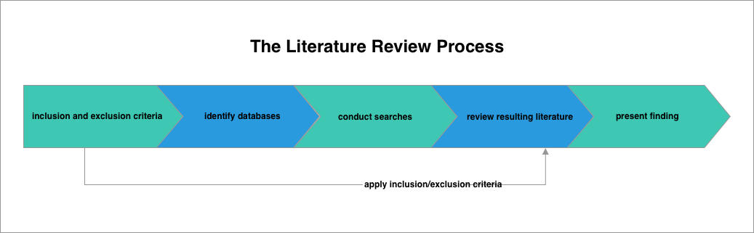
How to conduct a literature review
A literature review is the process of searching, critically appraising and interpreting the literature that relates to your research topic. Although there are many different types of reviews, within this unit and for your final year project we are going to be following a, somewhat, systematic approach.
A systematic literature review is one that follows a series of repeatable steps known as a 'protocol'. In this context a protocol is useful as it allows us to provide you with a recipe detailing how to conduct a literature review.

Slide 12
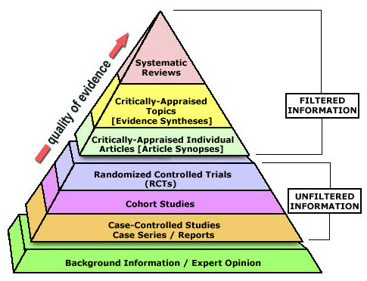
Evidence Pyramid
The levels of evidence pyramid provides a way to visualise both the quality of evidence and the amount of evidence available.
For example, systematic reviews are at the top of the pyramid, meaning they are both the highest level of evidence and the least common.
As you go down the pyramid, the amount of evidence will increase as the quality of the evidence decreases.
WALDEN UNIVERSITY, 2020. Academic Guides: Evidence-Based Practice Research: Levels of Evidence Pyramid [viewed 10 July 2023]. Available from: https://academicguides.waldenu.edu/library/healthevidence/evidencepyramid

Slide 13
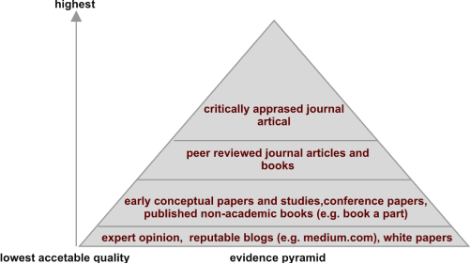

Slide 14

A literature survey can be either a key component of a larger paper such as a report or dissertation, or you may be asked to write one for its own sake.
A literature survey describes the existing and established theory and research in your report area. You are providing a context for your work.

Slide 15

A literature survey can also show where you are filling a perceived gap in the existing theory or knowledge, or you are proposing something that goes against existing ideas.
A literature review/survey can help the reader of your report get up-to-speed with where the thinking/developments are within your topic area/field of study.

Slide 16

It is also an opportunity to compare viewpoints/arguments and help you establish/ validate your approach.

Slide 17

Primary vs Secondary Sources
Primary sources are original first-hand accounts of an event that are written close to that event or time period.
Journal article reporting on new funding
Interviews
Data from a research study or government census
Secondary Sources are second-hand interpretations of primary sources. They draw on primary sources and come to conclusions based on work written by others.
Wikipedia
Literature reviews and meta-analyses
Newspaper/magazine articles

Slide 18

The Review Protocol
1. Develop inclusion and exclusion criteria
Inclusion and exclusion criteria help you identify what you need to search for when conducting your literature review. We will look an example of what the given criteria may look like for our chat bot application.

Slide 19

Inclusion Criteria
Primary sources relating to chat bots used for education or learning purposes
English language only
Published in peer reviewed journals
Study took place in the last 10 years
Empirical studies that took places in a higher education setting
The Study reported research methods and results

Slide 20

Exclusion Criteria
Sources that are related to chat bots not used in an educational or learning setting
Non-English language
Non peer reviewed sources
Study took place over 10 years ago
Study did not take place in a higher education setting
It is important to refer to and review your inclusion and exclusion criteria while you are searching.

Slide 21

2. Identify Databases
Once you know what type of literature you need to address your research idea and have developed your inclusion and exclusion criteria, you are ready to begin searching for literature. We recommend using online academic databases to conduct your search.
While the library has subscriptions to a range of databases, ScienceDirect is good.

Slide 22

3. Identify Keywords
You should identify the keywords that capture the essence of your research topic. The rationale behind this is that journal articles are indexed on databases using keywords.
Keywords
The keywords for are chat bot study could be as follows:
ChatBot, ChatBots, Chat Bot, ChatBot, Higher Education, University, Learning, Adult Education, Adults

Slide 23
4. Conduct searches
We are now ready to conduct our searches. When conducting your search you should make use of Boolean operators - AND/OR/NOT. These commands use the principles of Boolean logic, a concept that as a computing student you should be familiar with.
Using the above principles this is what our chat bot study search string might look like:
(Chatbot OR ChatBots OR Chat Bot OR Chat Bots) AND Learning AND (Higher Education OR Adult Education OR Adults)
https://www.sciencedirect.com/search?qs=ChatBot%2C%20ChatBots%2C%20Chat%20Bot%2C%20ChatBot%2C%20Higher%20Education%2C%20University%2C%20Learning%2C%20Adult%20Education%2C%20Adults&articleTypes=FLA&lastSelectedFacet=years&years=2021%2C2022%2C2023

Slide 24
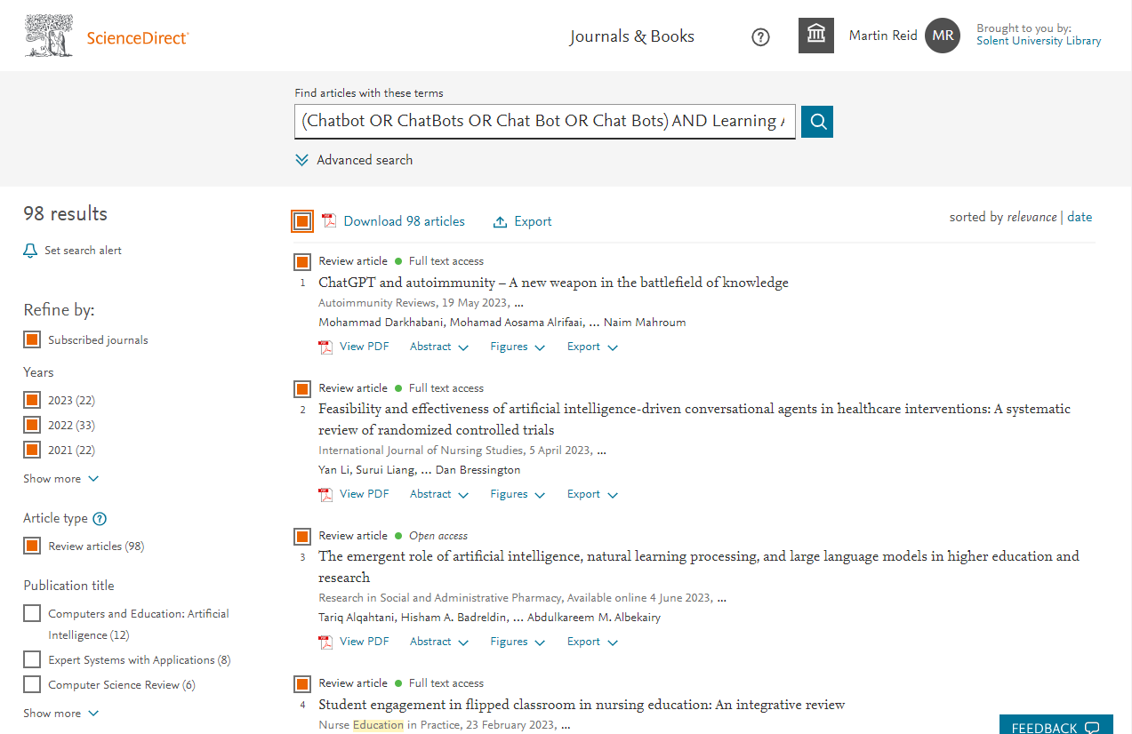
After conducting our search, we start applying our inclusion criteria.
We have filtered by date and just to include research articles.
After applying our criteria, you can see that we have 98 remaining articles. We now need to get the literature into a format that lends itself to more in-depth analysis.

Slide 25
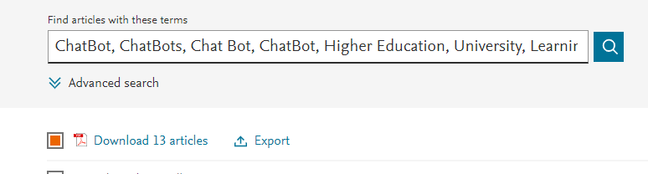
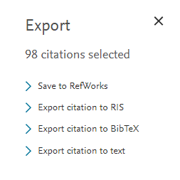
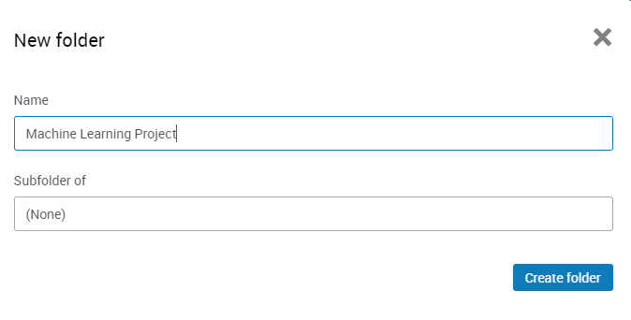
Exporting the search results to excel
ScienceDirect does not allow export to Excel.
Select all our sources & click export & 'Save to Refworks’ & create a new folder

Slide 26
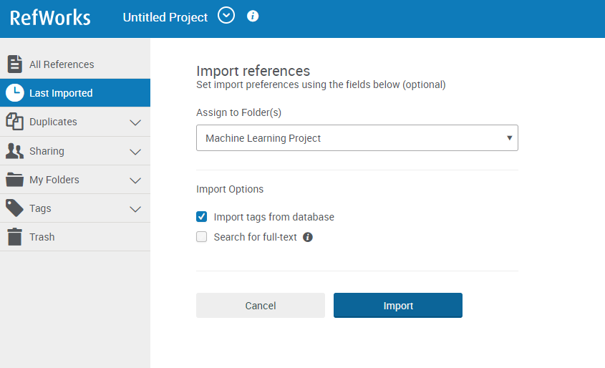

Slide 27
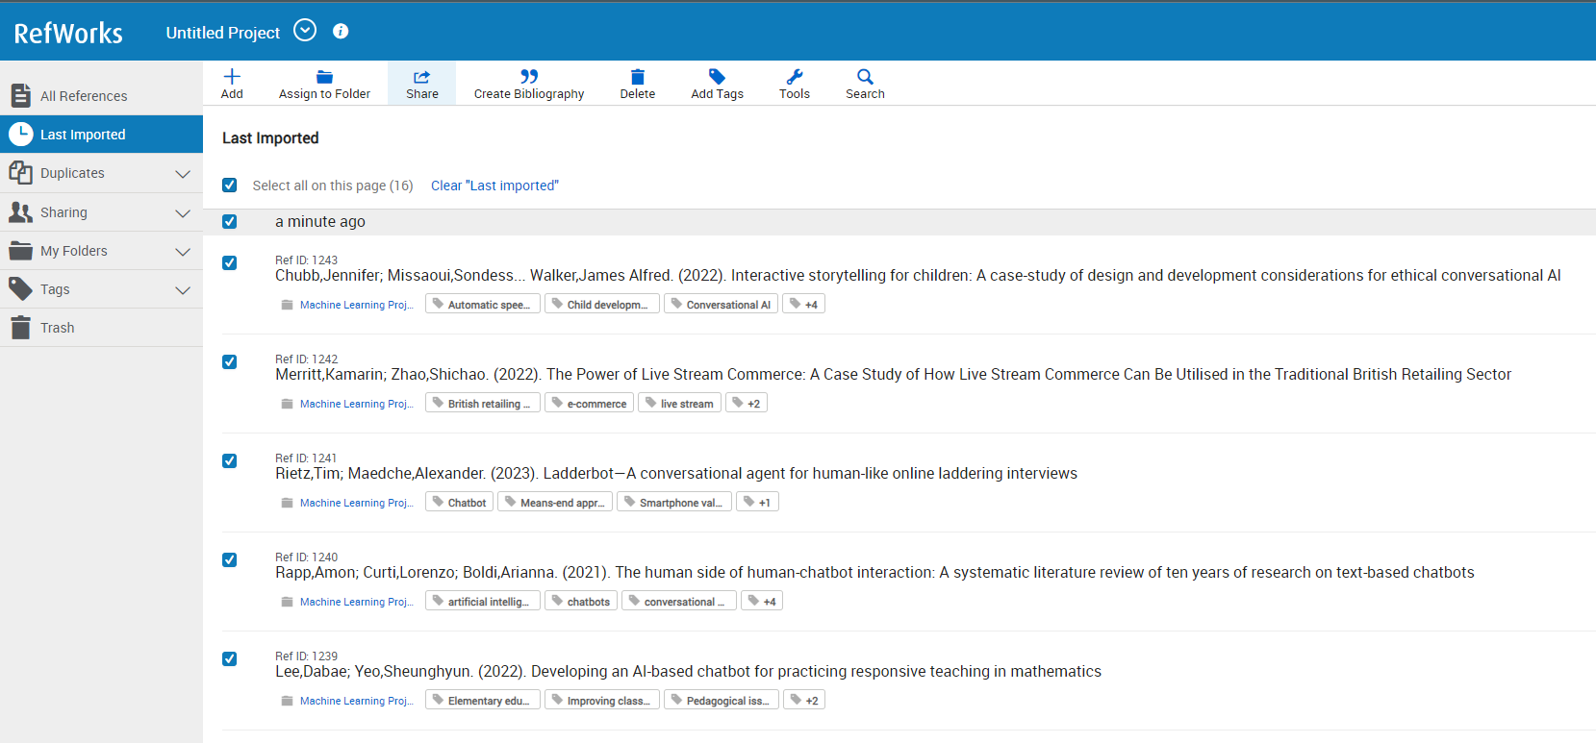
In RefWorks select your articles and click Share

Slide 28
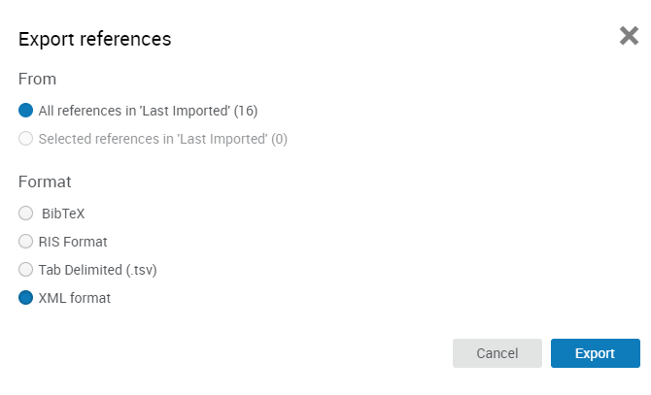
Export references -> XML or tsv

Slide 29
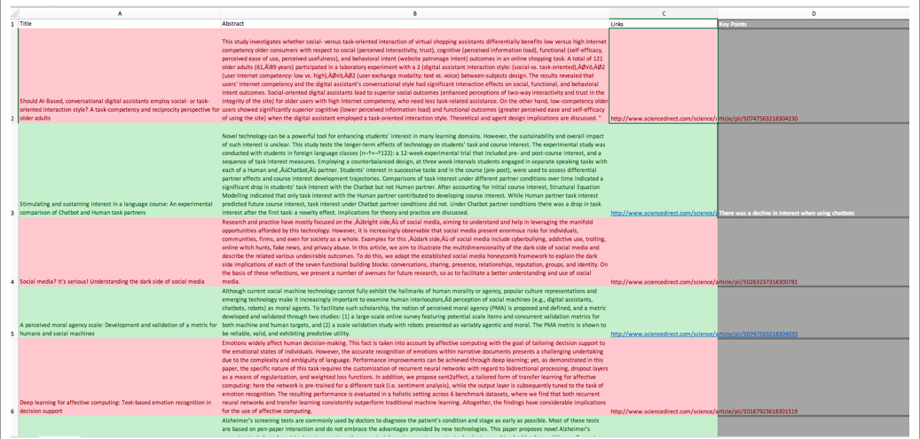
5. Review resulting literature

Slide 30
Now we have the results in Excel, initially we can just read the abstract of each article and make a quick decision if we want to include and discard the literature. Red rows represent excluded literature and green columns represent included literature.
You now should read the remaining papers aim good quality sources. You should aim to critically appraise and summarise each source.
Further Tips
Once you have identified the key articles that relate to your research idea, it is useful to study the reference lists of those key articles for further references that may be useful to you.
If a key theme or author keeps arising in your literature results, then it is well worth conducting further research into this given author

Slide 31
6. Summaries each study in a table
The first step is to summaries each of the papers you have
Author/Date | Aim Of Study | Data Collection Methods | Main findings | Sample
Jones (2009) | Explores the views of language students using a chat bot vs a human tutor to support learning | Quantitative surveys and focus groups | 70% of students preferred a human tutor over that of a chat bot | 40 undergraduate students

Slide 32
6.1 Compare and contrast each paper
After reading your papers it is now time to critically review and summarise studies.
Regarding the use of chat-bots for increasing learning, Smith (2006) explored how computing students interacted with this technology. He interviewed ten novice programming first-year university computing students about their experiences with using a chat-bot over the course of 10 weeks. Over the 10-week period, students attended, weekly, two-hour practical sessions where they undertook basic programming tasks using the programming language Python. Along with human tutor support, students also had access to a custom chat-bot implemented in botman.io. Students could query the chat-bot, in a natural language style, for programming support. It was identified that while some students found the tool useful the majority noted that it had no effect on their learning. This was a small study, undertaken by a researcher who was also teaching the students. As such, there may have been potential for observer biased. (Adapted from Aveyard, Helen. Doing A Literature Review In Health And Social Care : A Practical Guide, McGraw-Hill Education, 2014)
AVEYARD, H., 2014. Doing A Literature Review In Health And Social Care: A Practical Guide. Maidenhead: McGraw-Hill Education https://catalogue.solent.ac.uk/permalink/44SSU_INST/qgclbo/cdi_askewsholts_vlebooks_9780335263080

Slide 33
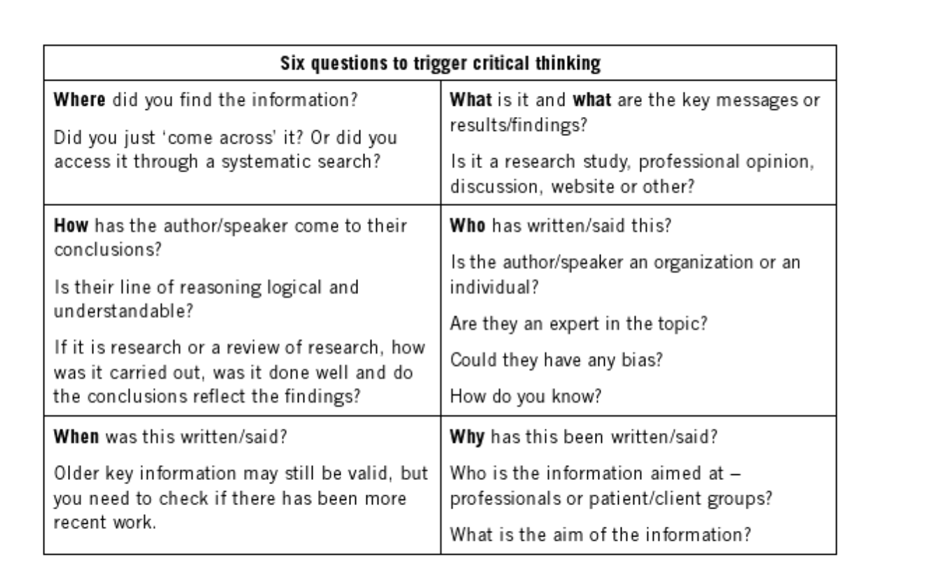
AVEYARD, H., 2014. Doing A Literature Review In Health And Social Care: A Practical Guide. Maidenhead: McGraw-Hill Education
https://catalogue.solent.ac.uk/permalink/44SSU_INST/qgclbo/cdi_askewsholts_vlebooks_9780335263080

Slide 34
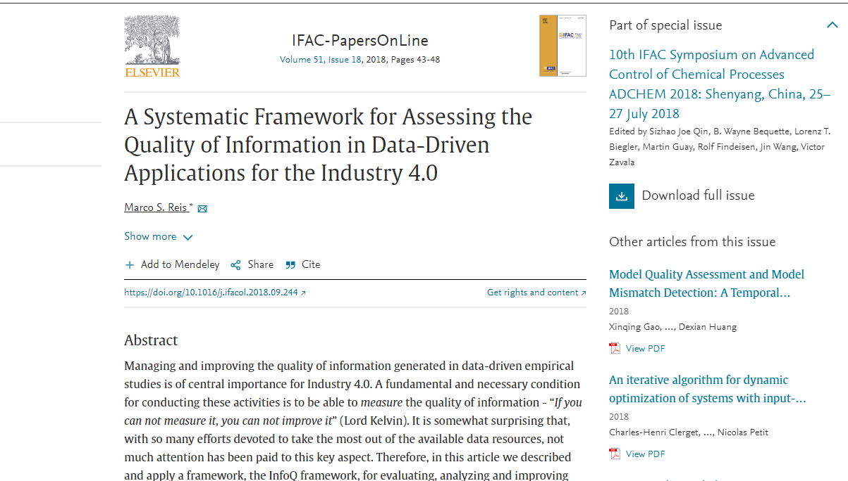
REIS, M.S., 2018. A Systematic Framework for Assessing the Quality of Information in Data-Driven Applications for the Industry 4.0, 51(18), 43–48 https://doi.org/10.1016/j.ifacol.2018.09.244

Slide 35
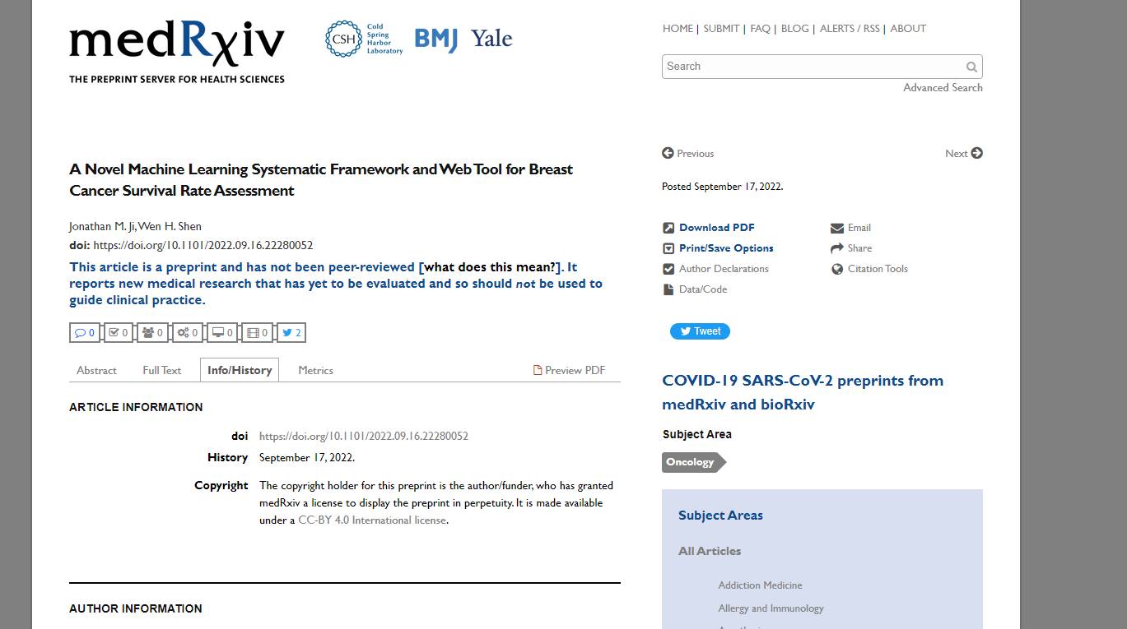

Slide 37
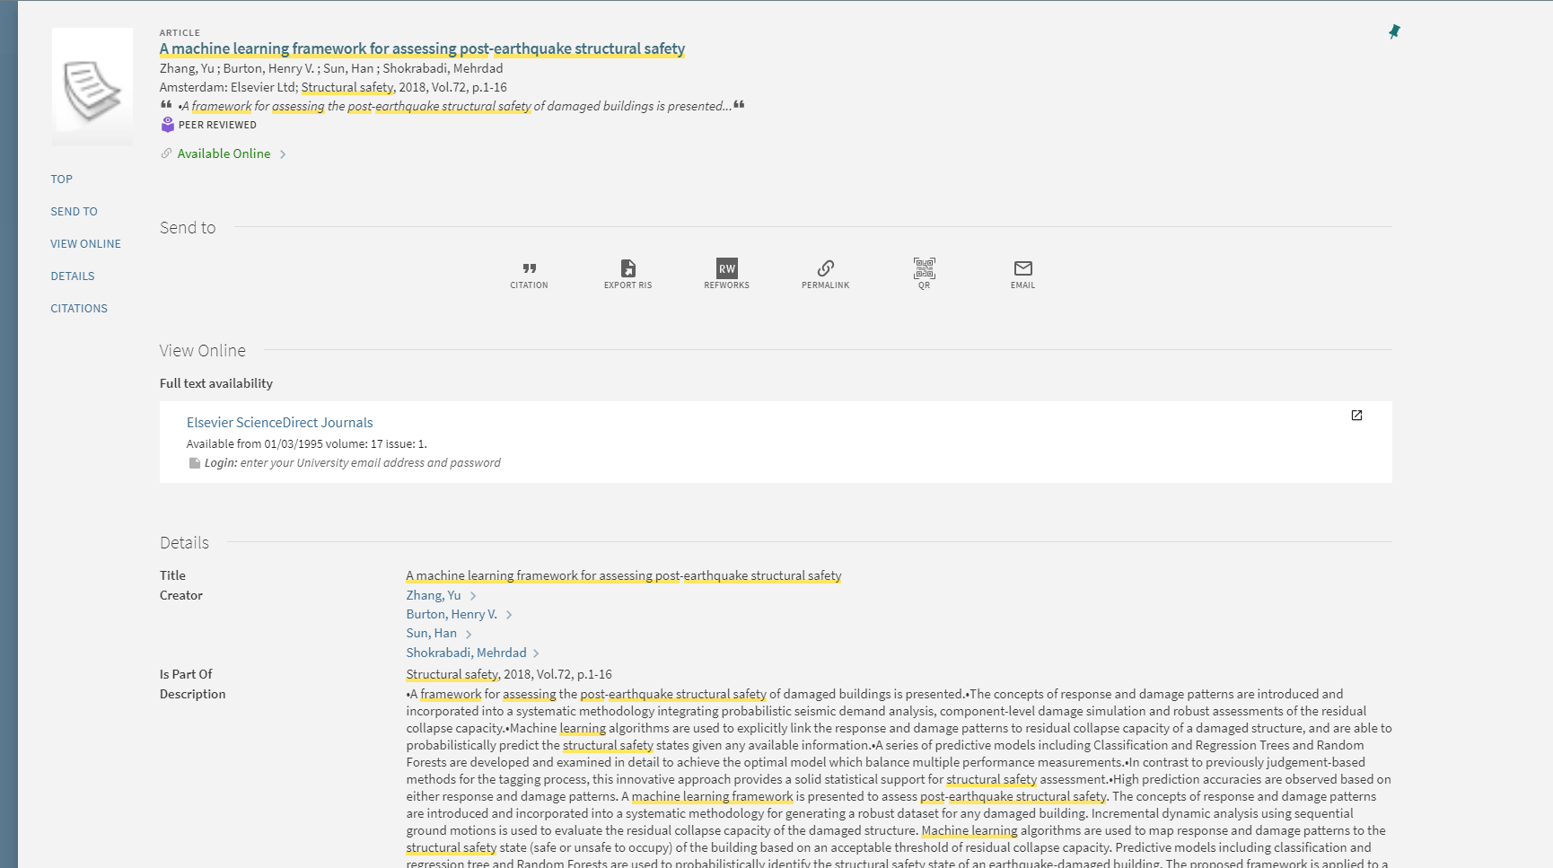
Zhang, Burton, H. V., Sun, H., & Shokrabadi, M. (, 2018). A machine learning framework for assessing post-earthquake structural safety. Structural Safety, 72, 1–16. https://doi.org/10.1016/j.strusafe.2017.12.001

Slide 39
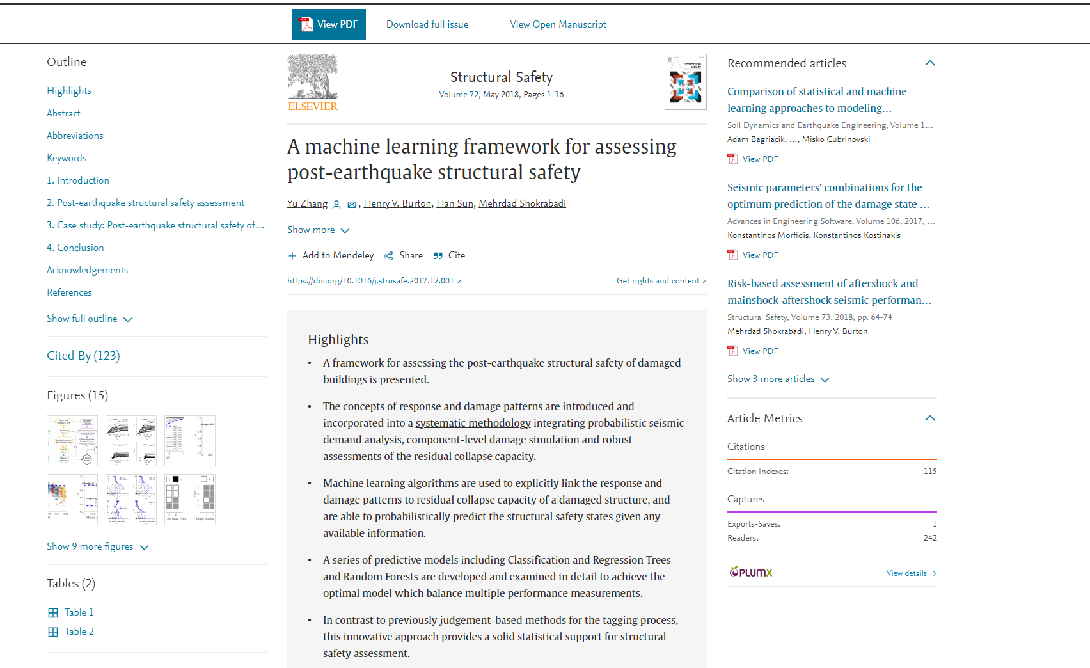

Slide 40

BHATTACHERJEE, A., 2012. Social Science Research: Principles, Methods, and Practices. Textbooks Collection

Slide 41
Thank you

